Slide 1

One Bone
Jolly Rogers

Slide 2









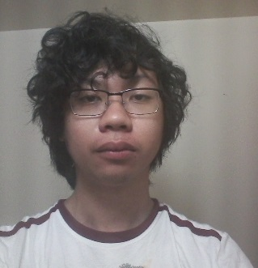

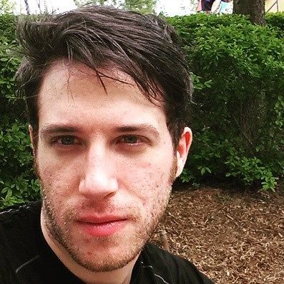
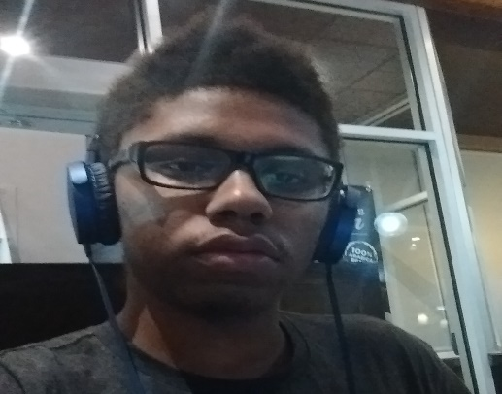
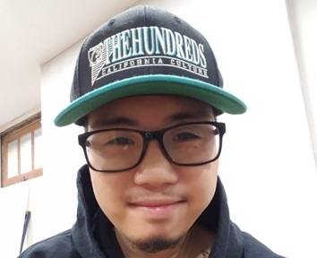

Roles
Software Engineer(s)
Project Manager
Artist
Game Designer
QA Tester
Aldrin Fernandez
Sargis Nahapetyan
Alessio Iannella
Kristian Campbell
Winston Heraldo
Shivam Sood
Manages GitHub repository
Responsible for adding in game features
Responsible for scripting and scene creation, works with the game designer
Maintains a logical coding standard
Oversees the entire project
Makes sure deadlines are met
Responsible for all documentation
Responsible for all art, sound and multimedia creation
Creation of original assets for the game
Minimizing all asset file sizes
Responsible for defining game mechanics
Makes sure all other roles are on track
Plans the layout of levels and game events
Tests all features of the game
Ensures the game is bug free
Creates feedback documentation

Slide 3



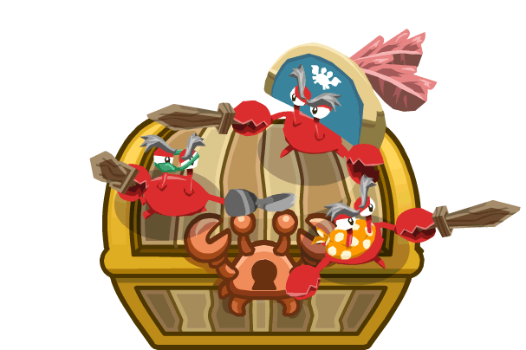
Game Definition
Game Overview
Game Play Mechanics
One Bones is a 2D platform game that follows Captain Bonnie Brinks and her crew in lifting their “skeleton curse.”
The game will bring the player into a pirate world where they will have to defeat enemies and overcome many obstacles in order to release them from the curse.
One Bones features two unique playable characters that can attack, jump and perform a different Travel Action. The player can switch between them with a single button. Each character can be upgraded with different weapons and power ups.
Needs (Need to do) | Wants (Want to do)
Two playable characters | Co-op
Travel actions | More levels
Upgrade system | More characters
Grappling hook | Additional upgradable weapons
Sword combat | Bosses
Gun combat | Online Co-op.

Slide 4
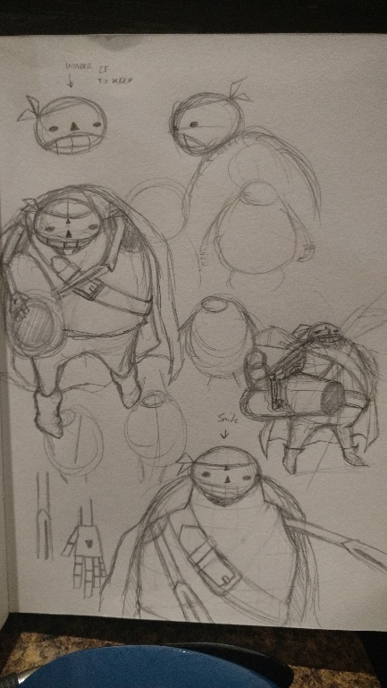
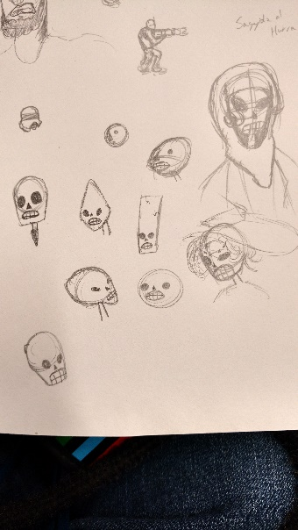

Game Overview
Captain Bonnie Brinks
Setting
Is a short-ranged fighter. She uses a sword to attack and has a Grappling Hook that allows her to swing from buildings.
Game takes place in a pirate themed world with humans and living skeletons coexisting.
Boss
A big character that does a lot of damage and has a significant amount of health.
Bobby Bazooka
Story
Is a long-ranged fighter. He specializes in projectile weapons and can swim through certain water areas.
Captain Bonnie Brinks forms a pirate crew of “Bone Thugs” to lift their curse and retrieve their stolen bones from what is believed to be the legendary Bone Thief.

Slide 5



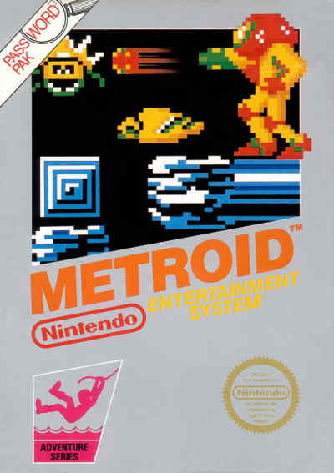

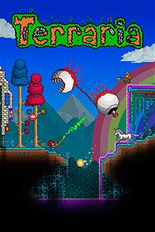
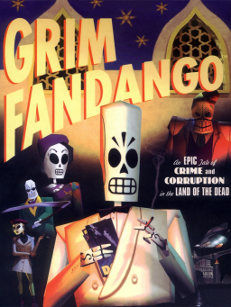
Planning
Games that influence us
Metroid
Super Mario Bros.
Terraria
Grim Fandango
Hook mechanic
Game template
Aim mechanic, art and gameplay
Art for characters

Slide 6



Preparation
How we keep on track
We will hand in assignments a day early
We will complete 55% of the work between the start and end of the due date
We will regularly keep track on one another
We will finish other assignments before starting our current one
We will finish our current assignment before starting others
We will divide the work appropriately
We will plunder your loot
160 XP
Captain
$0
80 XP
1st Mate
$1
40 XP
Quartermaster
$2
20 XP
Gunner
$3
0 XP
Cabin Boy
$5

Slide 7
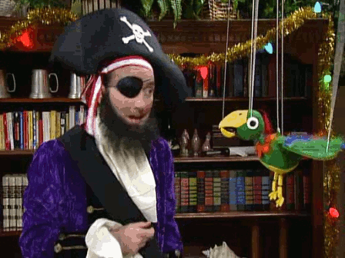
The End
Yea, were done

